Slide 1

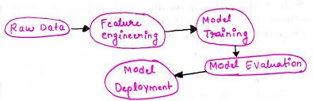
Feature Engineering
Feature Engineering is like giving your data a makeover before it meets a machine learning model.
It means cleaning, creating, transforming, selecting, or removing features (columns) so the model can understand patterns more clearly.
In short — it’s the art of turning raw data into smart data that helps machines learn better.
Why do we need feature engineering?
We need feature engineering because it helps improve model performance by turning raw data into meaningful inputs — making patterns clearer and predictions more accurate.

Slide 2
Imagine you start building a machine learning model using raw data like this:
Customer_ID | Age | Income | Gender | Purchase_Date | Spent
C101 | 25 | 50000 | M | 12/03/24 | 3000
C102 | NaN | 120000 | F | 03/04/24 | ?
C103 | 48 | - | Male | 2024/04/07 | 7000
If you train a model directly on this, it’ll struggle — because of missing ages, inconsistent formats, and unclear values.
That’s where feature engineering comes in. It cleans and prepares such data:
Fills missing values, ﬁxes date formats
Converts “Gender” to numbers (0/1)
Creates new features like “Monthly_Spending” or “Days_Since_Last_Purchase”
This turns raw, messy data into structured, meaningful input that helps the model learn patterns and predict accurately.

Slide 3
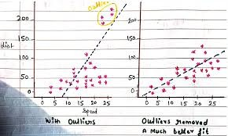
Understanding all steps of feature engineering with a case study
Case Study: Feature Engineering at a Card Company (e.g., Mastercard)
Scenario
Mastercard handles millions of transactions daily worldwide — from credit cards, ATMs, and online payments.
Each transaction includes details like amount, location, merchant type, time, device ID, and user history.
Managing this massive, fast-ﬂowing data requires high accuracy, security, and real-time processing.
Problem Statement
The company faces challenges such as:

Slide 4
Rising fraudulent transactions and suspicious payment patterns.
Inconsistent data from multiple systems and countries.
Difﬁculty in real-time fraud detection, as data streams in every second.
A need for a machine learning model that can identify and block fraud instantly before payment approval.
What the Data Science Team Does
To tackle this, Mastercard’s data scientists and ML engineers start with feature engineering — the most critical step before model training.
They can’t feed raw transaction data directly into the ML model — it’s too noisy, inconsistent, and incomplete.
So they perform feature engineering to make the data “model-ready.”
Feature Engineering on Mastercard Transaction Data
Once the raw transaction data is collected, the data science team begins feature engineering to prepare it for the fraud detection model.
Data Cleaning
  Remove duplicate or incomplete transactions.
  Standardize date, time, and currency formats across countries.
  Fix missing values (e.g., merchant or location) using imputation or reliable reference data.
→ Intuition: Clean data ensures reliability and prevents false fraud alerts.
Handling Missing Values
  Fill missing merchant types or locations using the user's past behavior or averages.
→ Intuition: Maintains data completeness and consistency for model training.

Slide 5
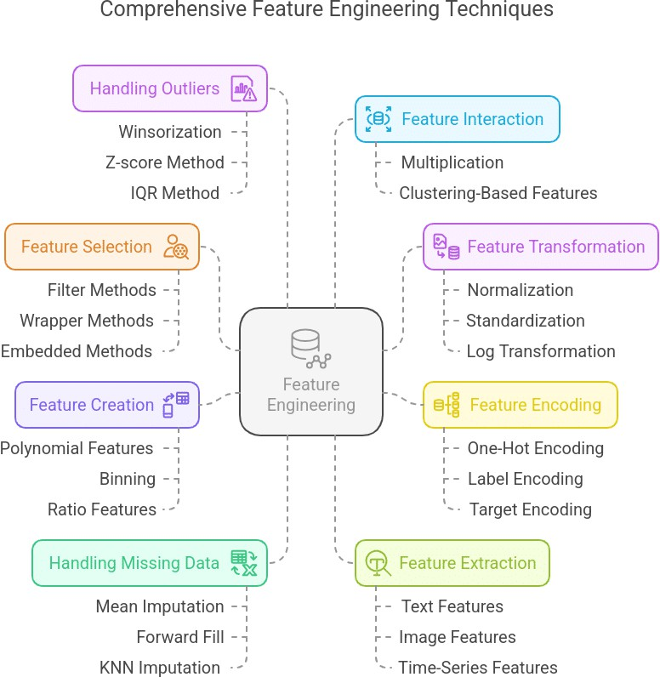
Encoding Categorical Data
  Convert text columns like “merchant type” or “payment mode” into numerical form using one-hot or label encoding.
→ Intuition: ML models understand numbers better than text.
4. Feature Scaling

Slide 6
Normalize or standardize features like transaction amount and time gap (e.g., using Z-score or Min-Max scaling).
→ Intuition: Prevents large numerical values from dominating smaller ones.
Feature Transformation
  Apply log or power transformations to reduce skewness in transaction amounts.
  Convert timestamps into parts like hour of day or day of week for better trend detection.
→ Intuition: Makes data more normally distributed and interpretable for the model.
Feature Creation
  Derive new features such as:
    Number of transactions in the last 5 minutes
    Average daily transaction per user
    Distance between current and last transaction location
→ Intuition: Captures behavioral patterns to detect unusual activity.
Feature Extraction
  Use mathematical or statistical methods (like PCA or embedding models) to derive compact representations from high-dimensional data.
→ Intuition: Reduces noise and highlights the most useful information.
Outlier Handling
  Detects and treats extreme transaction amounts using IQR or z-score.
→ Intuition: Prevents anomalies from skewing model predictions.
9. Feature Selection

Slide 7
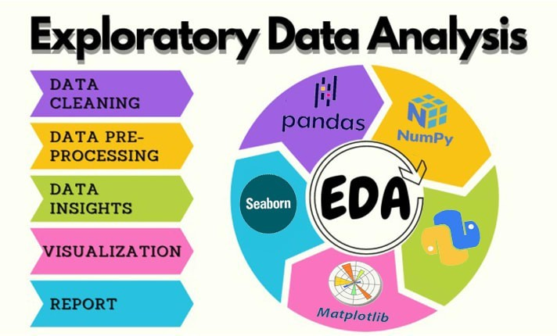
Drop irrelevant or repetitive columns (like anonymized card IDs or low-impact features).
Use correlation checks or feature importance scores.
→ Intuition: Keeps only what truly adds value to model performance.
EDA vs Feature Engineering
If we already explore data during EDA, then where exactly does feature engineering fit in — is it part of EDA or model building?
Feature engineering is technically a bridge between EDA and model building.
Technically, we explore and understand data during EDA, but we create and reﬁne features during feature engineering to make that data usable for machine learning models.

Slide 8
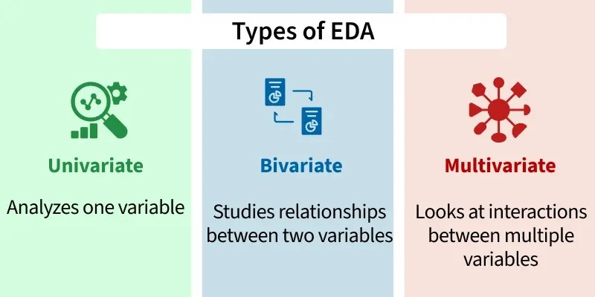
So, it’s not EDA itself, but a crucial part of the ML model preparation phase, guided by insights discovered in EDA.
Hence, in practice as well, keep EDA and model-building in separate notebooks. EDA focuses on understanding and visualizing data, while model notebooks handle preprocessing, feature engineering, and training.
This separation keeps workﬂows clean, modular, and easier to debug or reuse.
What next after feature engineering?
After feature engineering, we usually do data splitting and data balancing.
We split the data into training, validation, and test sets so the model learns, tunes, and is ﬁnally tested on unseen data — this prevents overﬁtting.

Slide 9
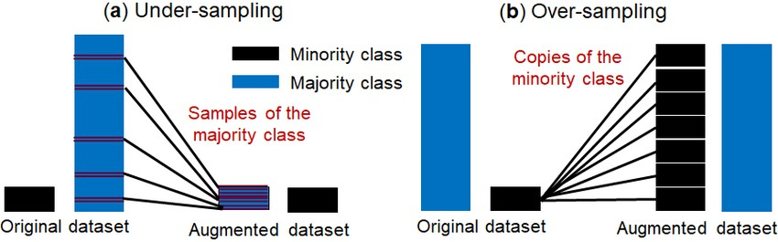
Then, we do data balancing (like oversampling or undersampling) to ﬁx unequal class counts, ensuring the model doesn’t get biased toward the majority class.
These steps aren’t part of feature engineering because they don’t change or create features — they deal with how data is organized and distributed for fair, effective model training.
FAQ’s regarding feature engineering
1. How do we know which features truly impact the model’s prediction?

Slide 10
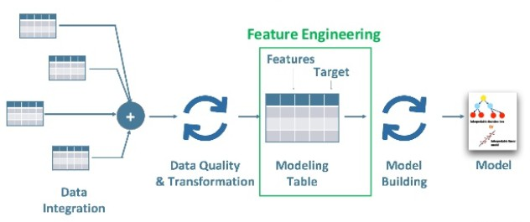
Ans. We can ﬁnd which features impact a model’s prediction using feature importance techniques — like model coefﬁcients (for linear models), feature importance scores (for tree models), or SHAP and LIME for deeper interpretability.
These methods show how much each feature contributes to the model’s output.
How do we engineer features for text, images, or audio data?
Ans. We engineer features from text, images, or audio by converting them into numerical form —
  For text: use word counts, TF-IDF, or embeddings.
  For images: extract pixel values or deep features from CNNs.
  For audio: use features like MFCCs, pitch, or frequency patterns.
3. What happens if we skip feature engineering altogether?
Ans. If we skip feature engineering: the model gets raw, unstructured data and may fail to learn useful patterns — leading to poor accuracy.
Can bad feature engineering make a good model perform poorly?
Ans. Bad feature engineering: yes, it can make even a strong model perform poorly, because wrong or noisy features confuse the model and reduce its predictive power.
How does EDA guide feature engineering?

Slide 11
Ans. EDA helps us understand data patterns, correlations, and issues — guiding what features to create, transform, or remove.
When should we stop creating new features?
Ans. Stop when new features don’t improve model performance or add redundancy, and the model becomes complex without real gain.
How do we handle unseen categories in test data?
Ans. Use techniques like “unknown” category tagging, frequency encoding, or models that handle unseen values gracefully (like tree-based models).
Does feature engineering differ for deep learning models?
Ans. Yes — deep learning often needs less manual feature engineering, as models learn features automatically from raw data.
How do domain experts help in creating better features?
Ans. They provide real-world insights that guide meaningful feature creation — linking data patterns to actual business or user behavior.
What do we do in feature scaling?
Ans. In feature scaling, we adjust numerical values so all features are on a similar range or scale.
This helps models learn faster and treat each feature equally.

Slide 12
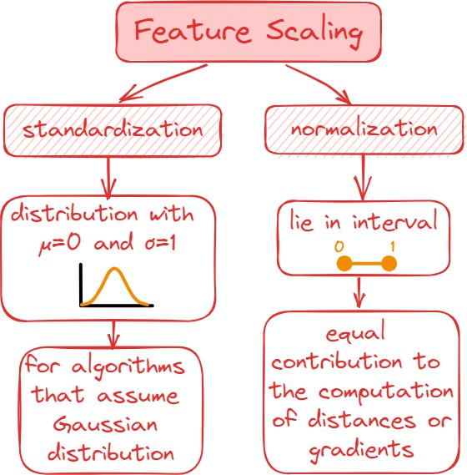
Common methods:
Normalization (Min-Max Scaling): rescale values between 0 and 1.
Standardization (Z-score Scaling): center data around mean 0 and standard deviation 1.

Slide 13
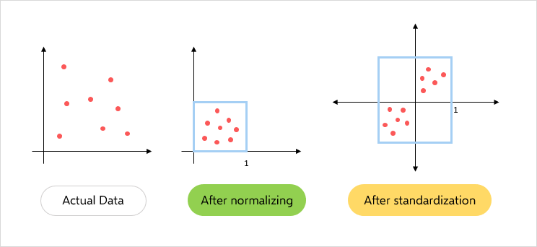
11.Why is feature scaling really impactful?
Ans. Feature scaling is impactful because it makes all features contribute equally to the model’s learning process.
Without scaling, features with large values (like income) can dominate smaller ones (like age), causing biased results.
It also helps models like linear regression, k-means, and neural networks converge faster and perform more accurately.

